Slide 1


Git

Slide 2
Git Basics
What is version control?
Centralized
Distributed
What is Git?
Installation of Git
How to create a Git repository?
Git workflow
Basic Git commands
Branches

Slide 3
Git Advance
Branches
Creating and Using Branches
Resolving Merge Conflicts
Merging Branches
Merge and Resolve Conflict
Stash and Pop
Navigating History
Restore
Checkout
Reset
Revert
diff

Slide 4
Git and Team Working
Usage of Remote Repository
Project Management
Issue and pull request management in GitHub/Bitbucket
Conflict Management
Git ignore (.gitignore)
Git Automation
CI/CD pipeline integration

Slide 5
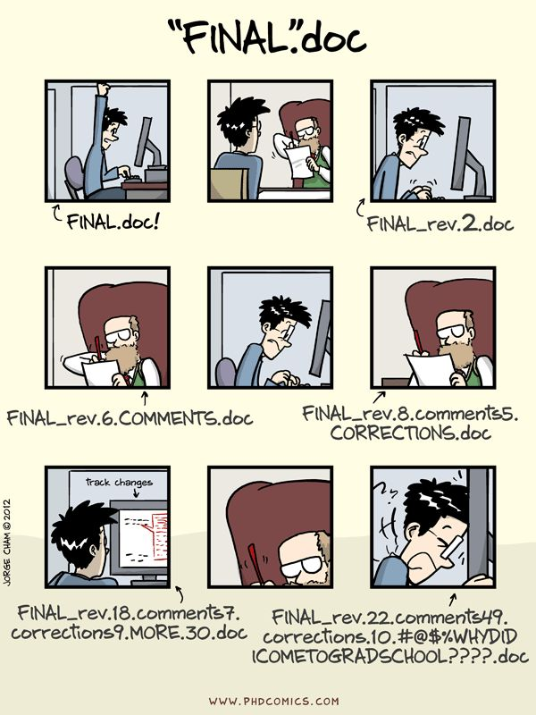
What is version control?

Slide 6
What is version control?
Track changes on text files / source files for you
Unlimited Undo / Redo
Time Travel
Collaborative development environment
Compare and Blame
What changed
When it changed
Why it changed
Who changed it

Slide 7
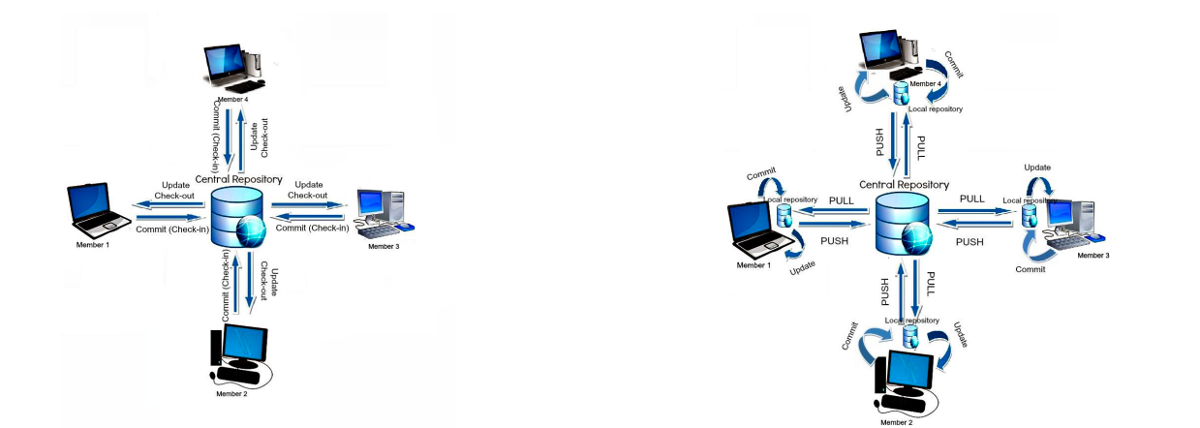
What is version control?
Centralized
You need to be connected to the server
Distributed
You can work while offline

Slide 8
What is Git?
Git is a software
Content Tracker
Distributed Version Control System (VCS)
Linus Torvalds

Slide 9
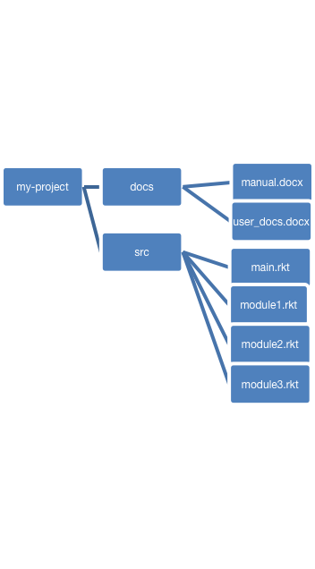
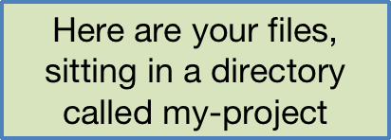
What is Git?

Slide 10
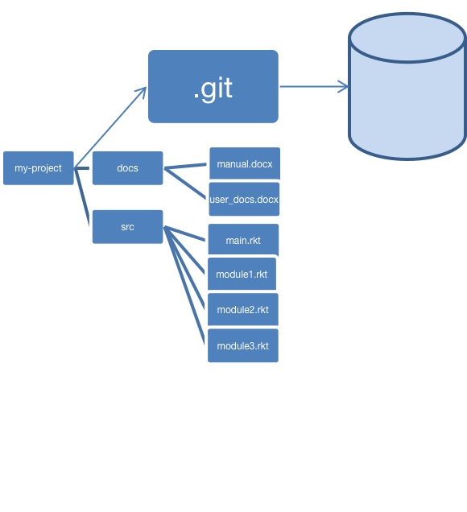
What is Git?
When you have a git repository, you have an additional directory called .git, which points at a mini-filesystem.
This mini-filesystem is highly optimized and very complicated. Don’t try to read it directly.
When you have a git repository, you have an additional directory called .git, which points at a mini-filesystem.
This mini-filesystem is highly optimized and very complicated. Don’t try to read it directly.

Slide 11

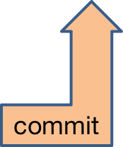
What is Git?
When you do a “commit”, you record all your local changes into the mini-fs.
The mini-fs is “append-only”. Nothing is ever over-written there, so everything you ever commit can be recovered.

Slide 12
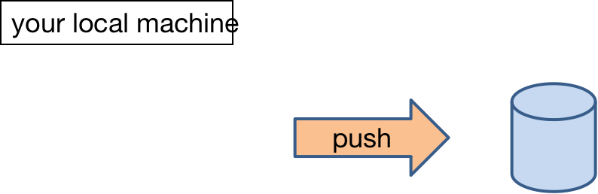

What is Git?
a server, somewhere on the internet, eg. bitbucket, github.com
At the end of each work session, you need to save your changes on the server. This is called a “push”.
Now all your data is backed up.
You can retrieve it, on your machine or some other machine.
We can retrieve it (that’s how we collect homework)

Slide 13
Installation of Git
Is there anyone who hasn't installed Git and VsCode on their machine?
https://git-scm.com/downloads
https://code.visualstudio.com/download

Slide 14
How to create a Git repository?
Let’s check if you have git in your computer
git --ve
git needs your identity
git config --global user.git config --global user.email
git --version
git config --global user.email “your mail adress”
git config --global user.name “your name”
git config –list

Slide 15
How to create a Git repository?
to create a new local repo
git --ve
to see the commands
git config --global user.git config --global user.email
git init
git help
to see the status of your repo
git status

Slide 16
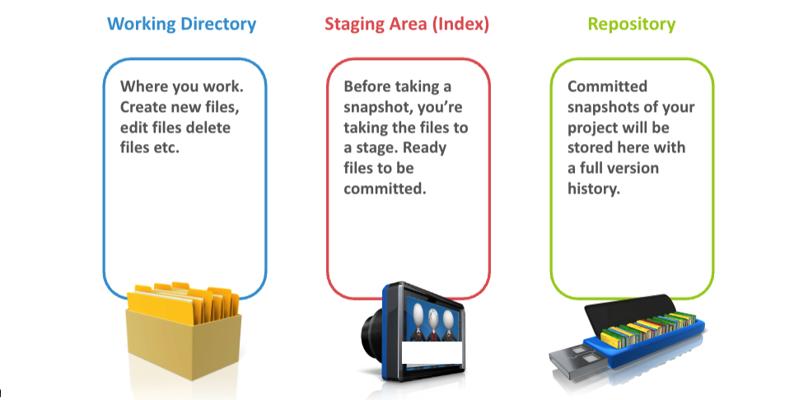
Git Workflow

Slide 17
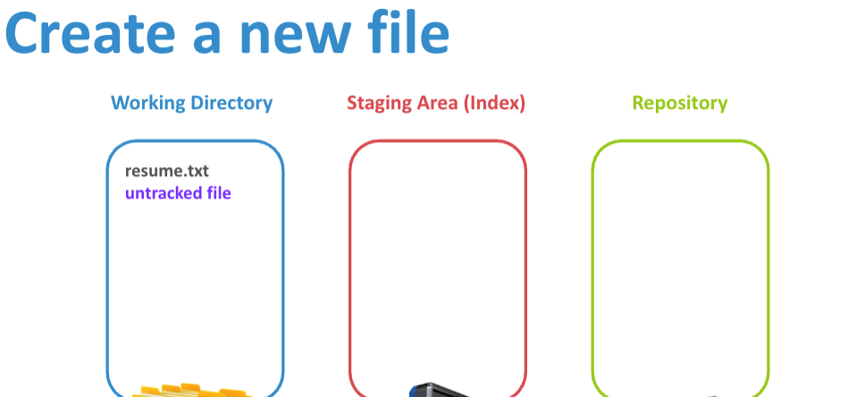
Git Workflow

Slide 18
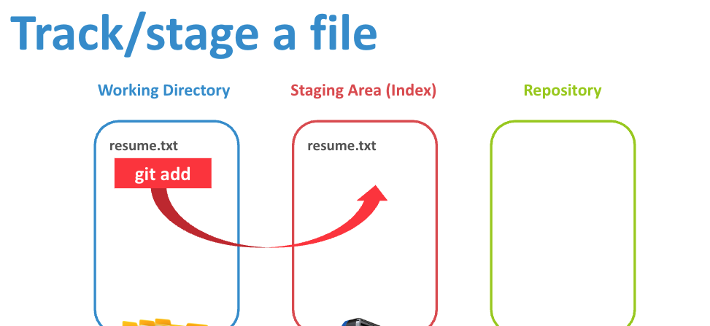
Git Workflow

Slide 19
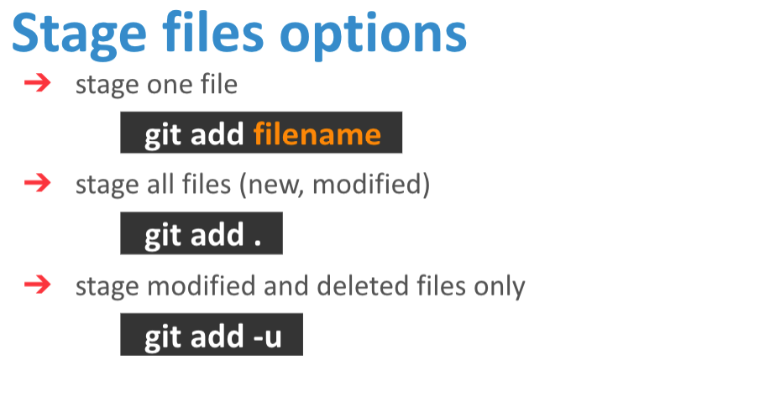
Git Workflow

Slide 20
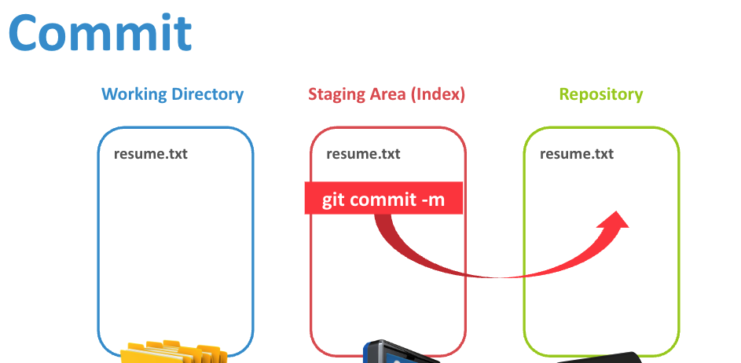
Git Workflow

Slide 21
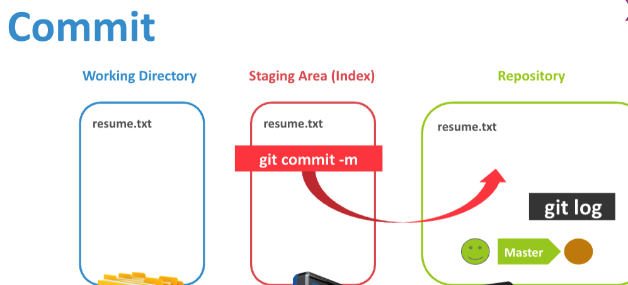
Git Workflow

Slide 22
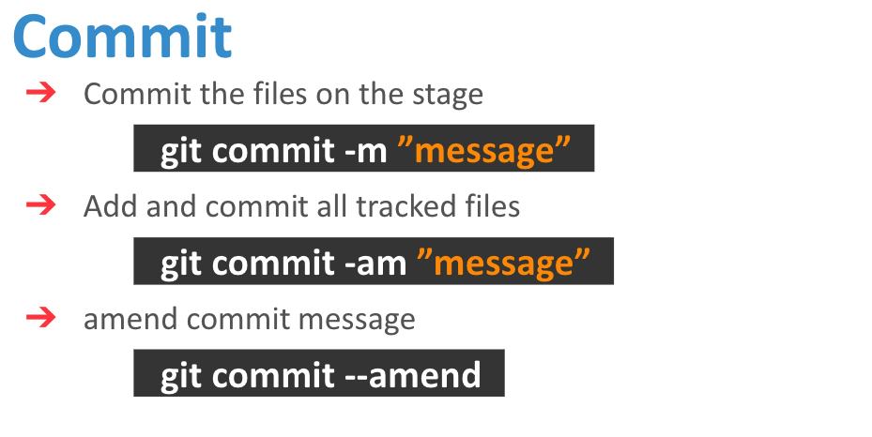
Git Workflow

Slide 23
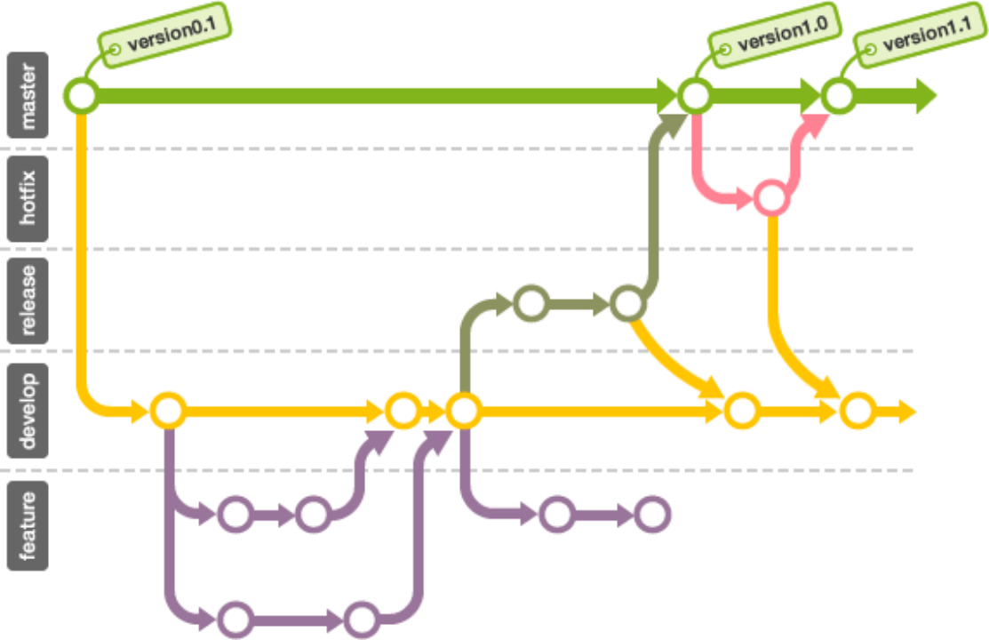
Branches

Slide 24
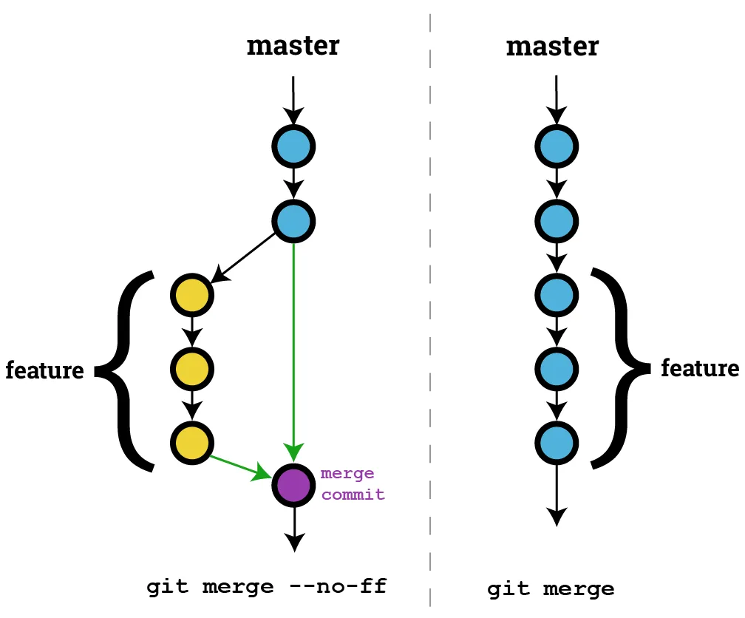
Merge & Resolve Conflict
Fast Forwarding

Slide 25
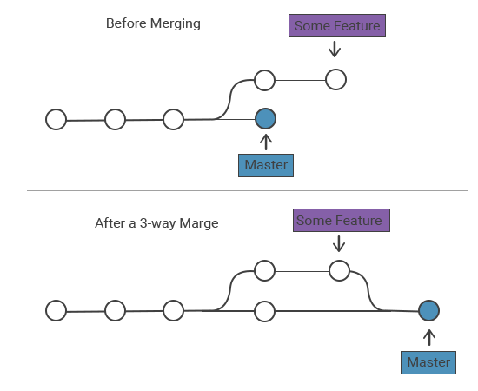
Merge & Resolve Conflict
3-way Merge

Slide 26
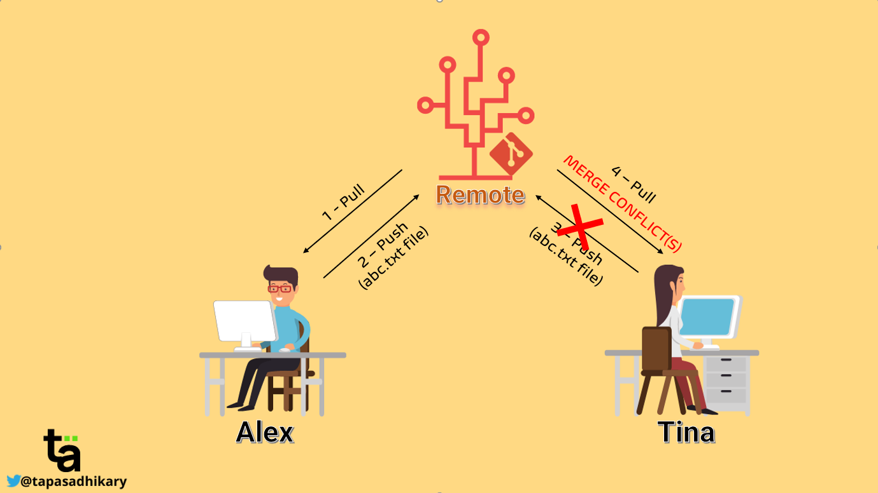
Merge & Resolve Conflict

Slide 27
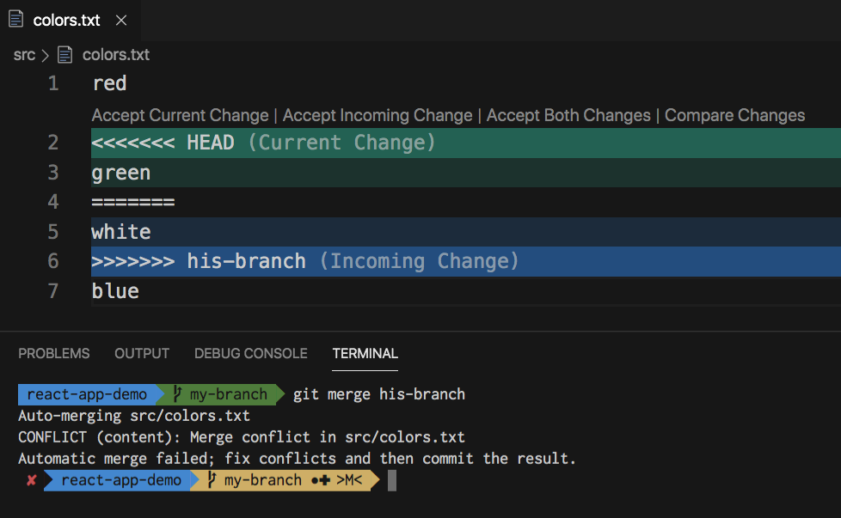
Merge & Resolve Conflict

Slide 28
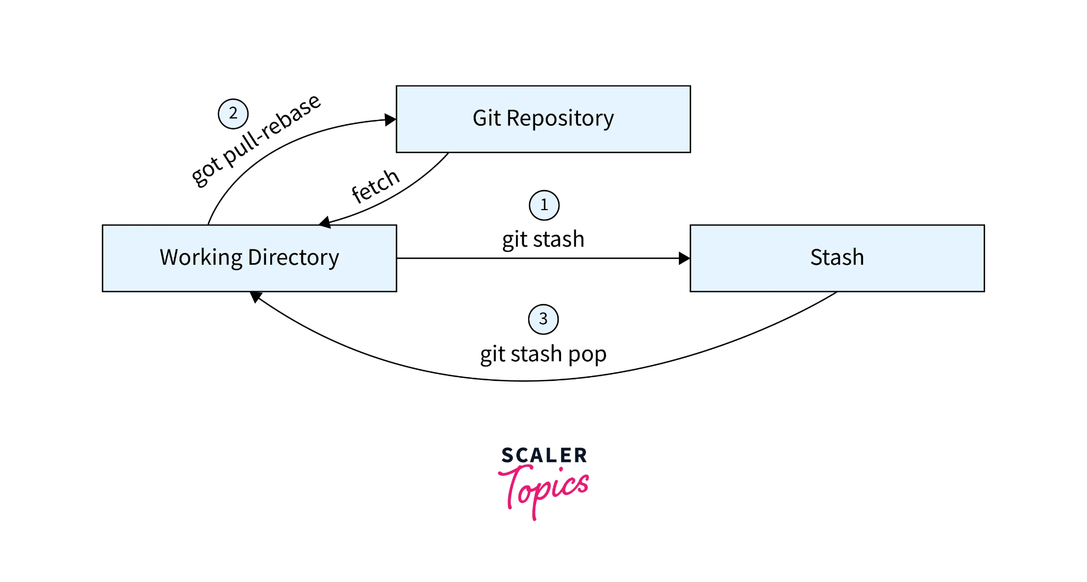
Stash & Pop

Slide 29
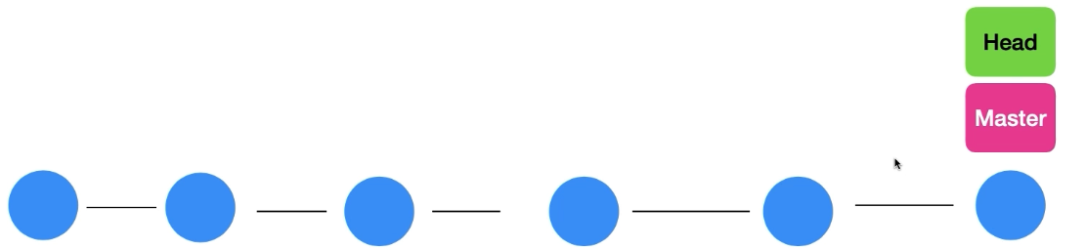
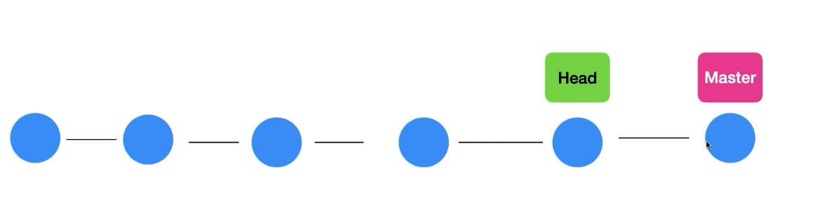
Navigating History
Checkout
git checkout <before_hash>
git switch master

Slide 30
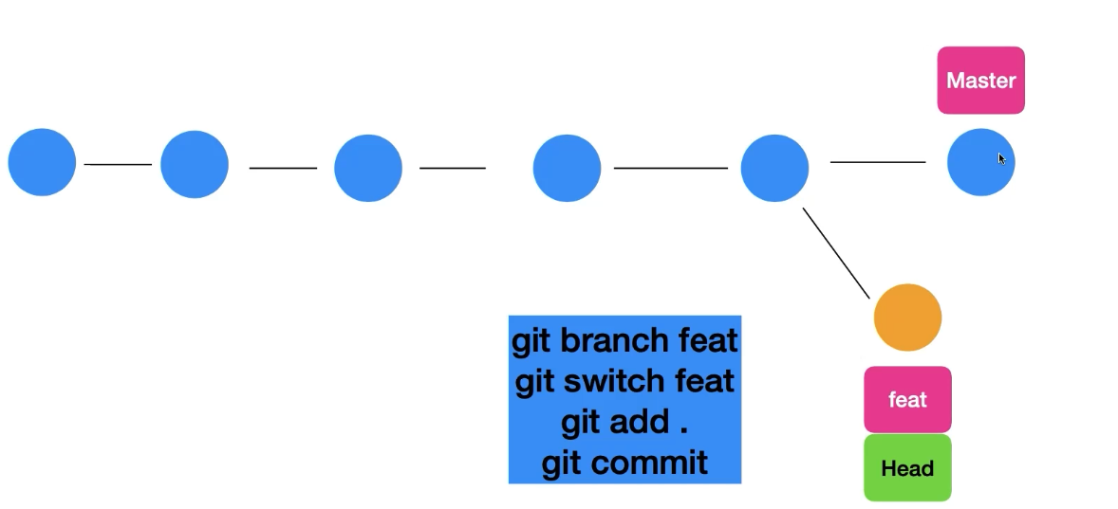
Navigating History
Checkout

Slide 31
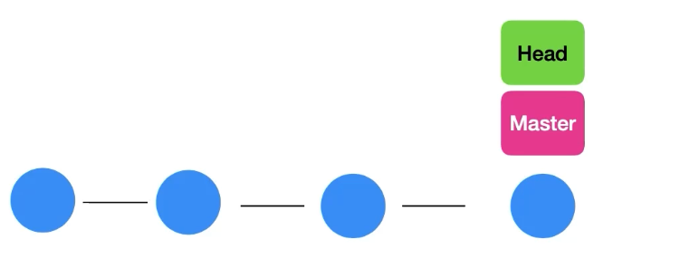
Navigating History
Reset
git reset -- hard <commit_hash>

Slide 32
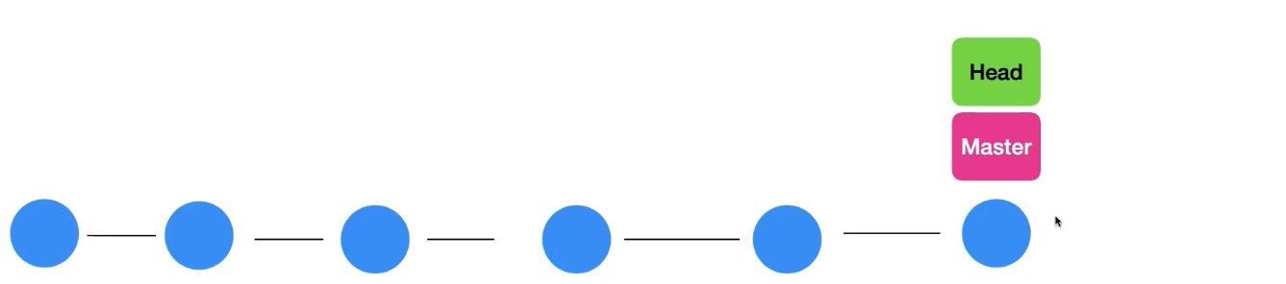
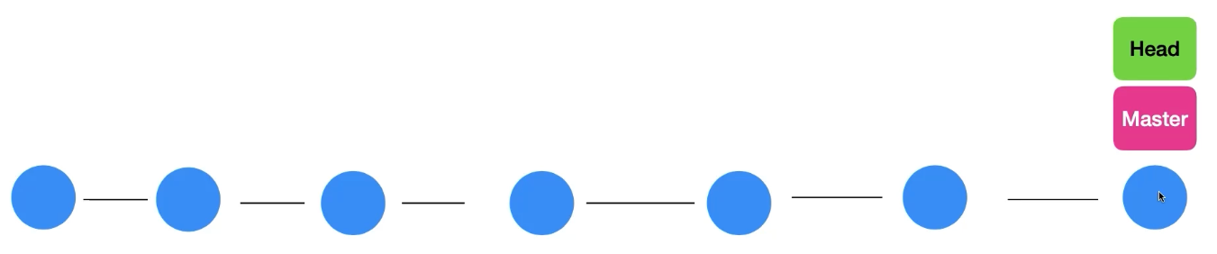
Navigating History
Revert
git revert <commit_hash>

Slide 33
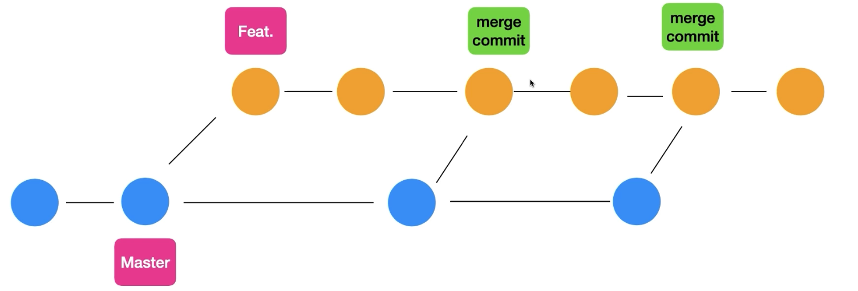
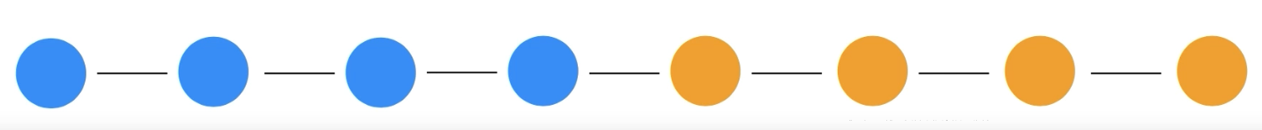
Navigating History
Rebasing
git switch feat Git rebase main

Slide 34
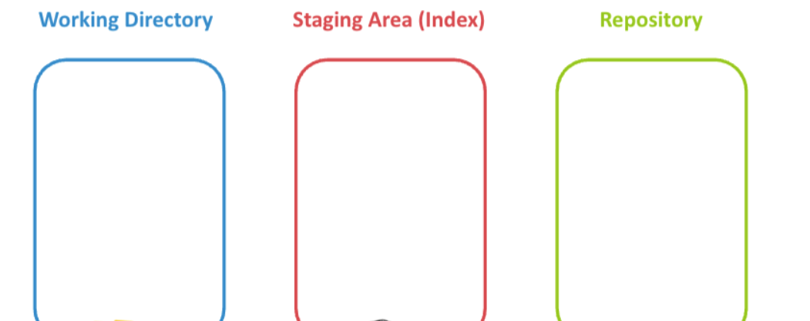
Navigating History
git restore <file_name>
git restore --staged <file_name>
git reset --soft HEAD^
git reset HEAD^
git reset --hard HEAD^

Slide 35
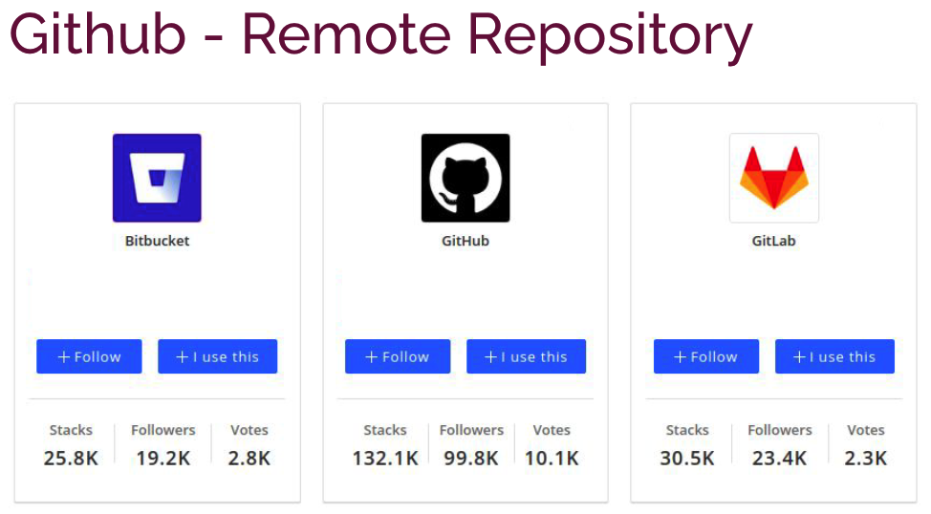

Slide 36
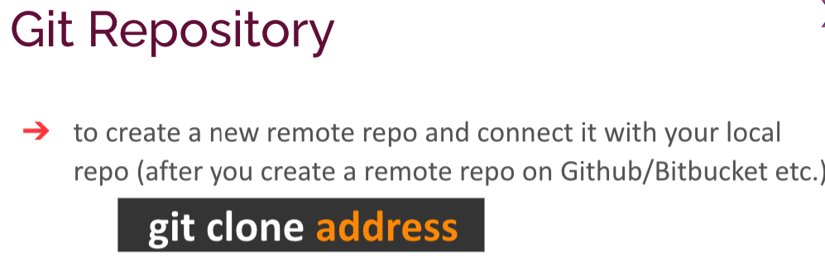

Slide 37
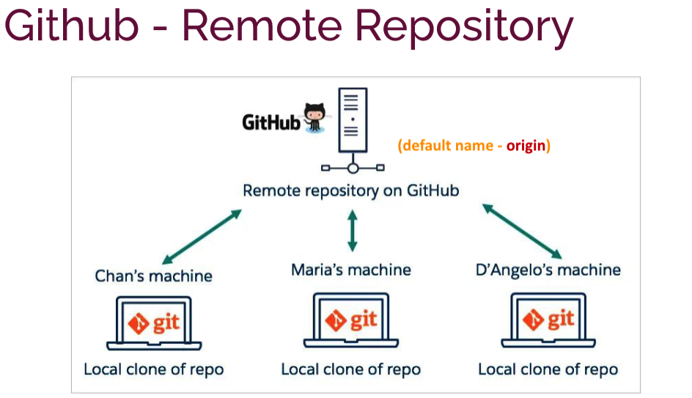

Slide 38
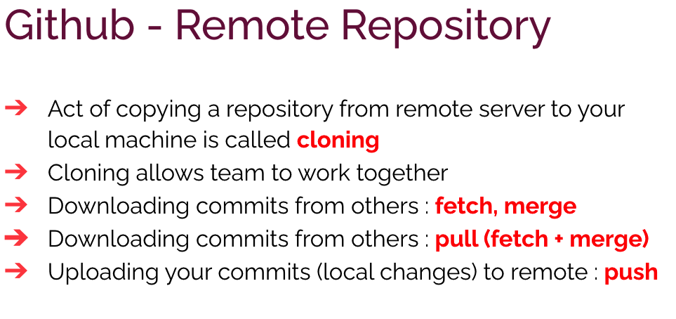

Slide 39
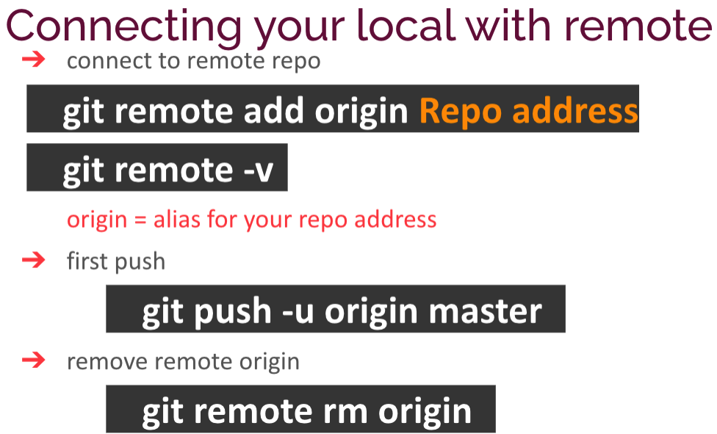

Slide 40
